Slide 1


Predicting Wave Energy Generation
A Data-Driven Approach for UAE Renewable Planning
CSC1323 - MODERN ARTIFICIAL INTELLIGENCE | WINTER 2026
University of Wollongong in Dubai
Group: Alkhaiyat | Sathik | Saeed | Tulsiyani | Chorera | Imran | Abdulrahman
UOWD Project Presentation
Slide 1 of 15

Slide 2


INDUSTRY & DOMAIN OVERVIEW
Blue Energy: The Next Frontier
Wave energy remains a high-density renewable resource essential for UAE's Energy Strategy 2050 targets.
Market Potential: Projected growth to $1.2B by 2030 (7.5% CAGR).
UAE Context: Diversifying beyond solar to ensure 50% clean energy mix.
AI Significance: Critical for managing the intermittency of maritime power.
Domain Research
Slide 2 of 15

Slide 3






PROBLEM STATEMENT & MOTIVATION
Technical Barrier
Business Value
Success Metrics
Individual WECs interfere with each other (the "Shadow Effect"), reducing overall farm efficiency by 15-20% if misaligned.
Traditional simulations take weeks. AI-driven forecasting provides real-time ROI assessment for coastal investors.
Targeting a reduction in RMSE below 50k and increasing prediction speed by 100x vs. numerical models.
Context & Vision
Slide 3 of 15

Slide 4


AI APPLICATIONS IN INDUSTRY (SOTA)
Current Techniques
Our Contribution
LSTMs: Used for temporal forecasting.
Bridges the gap by focusing on Spatial Multicollinearity using L2-regularized linear models and Deep Neural Networks to capture complex array interactions.
Genetic Algs: Used for layout optimization.
CNNs: Applied to wave height imagery.
State-of-the-Art Analysis
Slide 4 of 15

Slide 5
COMPETITIVE LANDSCAPE
Solution Category | Leading Platforms | Our Competitive Edge
Numerical Solvers | WAMIT, ANSYS AQWA | 100x faster inference; Low compute cost.
Cloud Platforms | AWS Energy, Microsoft Ocean | Customized for UAE maritime wave frequencies.
Academic SOTA | Transformer-based hybrids | Stable L2 regularization for spatial features.
Gap Analysis: Existing solutions lack focus on low-data environments common in new farm sites.
Market Gap Analysis
Slide 5 of 15

Slide 6
INDUSTRY-SPECIFIC CHALLENGES
Data Availability: UAE-specific long-term wave datasets are limited, requiring robust generalization from global (Australian) data.
Regulatory Compliance: Models must adhere to UAE Ministry of Infrastructure standards for offshore deployment.
Cost-Benefit Analysis: High ROI depends on Prediction Accuracy > 90% to justify deployment risks.
Privacy: Sensor data from strategic coastal zones requires secure, ethical handling.
Risk & Regulation
Slide 6 of 15

Slide 7

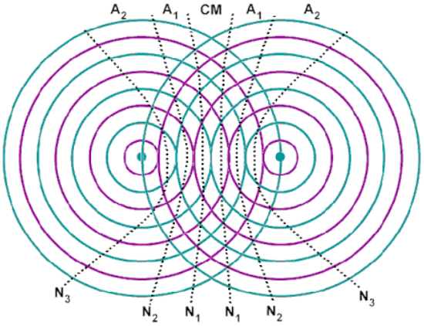

TECHNICAL APPROACH & METHODOLOGY
Advanced Feature Engineering
Utilized a custom DistanceTransformer to encode spatial relationships.
Algorithm: Ridge Regression (L2 penalty) for stability.
Deep Learning: 4-Layer MLP with Dropout (0.2).
Scaling: StandardScaler for numeric convergence.
Solution Architecture
Slide 7 of 15

Slide 8


SYSTEM WORKFLOW & PIPELINE
Data Prep
Engineering
Training
Validation
Ingestion of 4 regional CSVs & 5-Fold Splitting.
Distance calculations & coordinate scaling.
Hyperparameter tuning via GridSearchCV.
RMSE/MAE checks & Residual Analysis.
Modular Pipeline: Designed for integration with cloud monitoring systems.
Engineering Pipeline
Slide 8 of 15

Slide 9
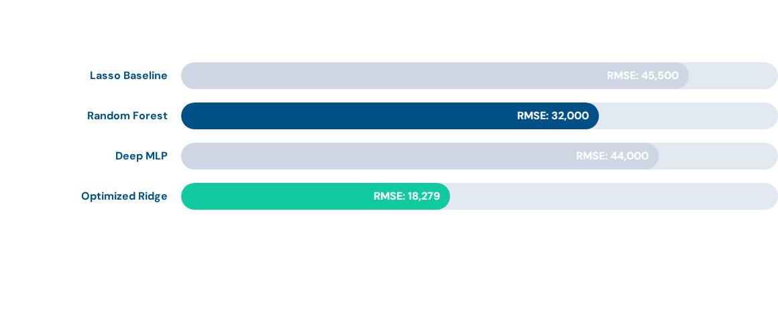
KEY RESULTS & BENCHMARKS
Ridge Regression emerged as the most robust model for spatial prediction.
Performance Evaluation
Slide 9 of 15

Slide 10

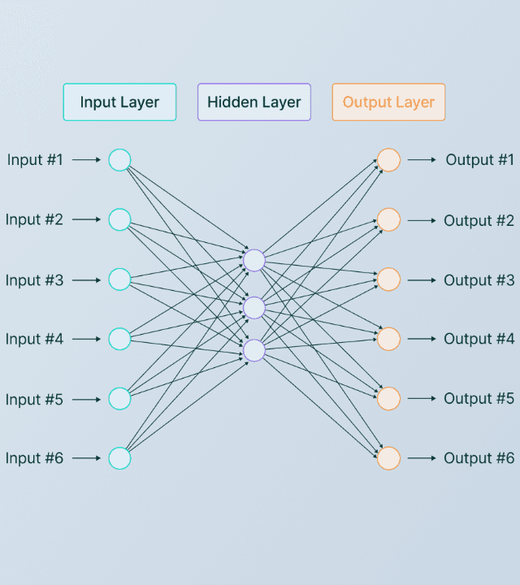
PROJECT INNOVATION
Advancing the SOTA
Our solution introduces a Spatial-Interaction Layer within the machine learning pipeline, specifically designed to address multicollinearity in high-density wave arrays.
Innovation 1: Distance-matrix feature augmentation.
Innovation 2: Region-specific cross-validation.
Innovation 3: Optimized L2 penalty for oceanic data.

Slide 11


LIMITATIONS & LESSONS LEARNED
Technical Constraints
Key Takeaways
Model performance varies by region (e.g., Tasmania RMSE was higher due to extreme wave variance). Scaling to 100+ buoys requires distributed training.
Simpler models (Ridge) often outperform deep learning when spatial correlation is strong and data noise is prevalent.
Critical Assessment
Slide 11 of 15

Slide 12






RECOMMENDATIONS & FUTURE WORK
Cloud Deployment
Genetic Algs
Domain Scaling
Deploy using Azure ML for real-time monitoring of UAE coastal sensors.
Integrate our Ridge predictor with GA for automated buoy layout generation.
Adapting the model for offshore solar and hybrid wind-wave farms.
Strategic Roadmap
Slide 12 of 15

Slide 13


Strategic Impact Summary
Our project demonstrates that AI can significantly reduce the engineering barriers for marine energy. By aligning with the UAE Energy Strategy 2050, we provide a blueprint for a sustainable, data-driven maritime economy in the GCC region. Accuracy, interpretability, and speed are now within reach for renewable planners.

Slide 14
Questions?
Thank you for your attention.
Group Project: CSCI323 - Winter 2026
University of Wollongong in Dubai
Engagement Session
Slide 14 of 15

Slide 15
REFERENCES
Type | Source
Academic | Breiman, L. (2001). "Random forests". Machine Learning, 45(1).
Policy | UAE Ministry of Energy and Infrastructure (2020). "UAE Energy Strategy 2050".
Dataset | UCI Machine Learning Repository (2019). "Wave Energy Converters Dataset".
Industry | McKinsey Global Survey (2024). "The state of AI in 2024".
Research | Falnes, J. (2007). "A review of wave-energy extraction". Marine Structures.
End of Presentation
Slide 15 of 15

Slide 16




IMAGE SOURCES
https://webapi.bnw.ae/uploads/Beautiful_Dubai_62dfc73920.png
Source: bnw.ae
https://www.physicslab.org/img/83304889-3f29-417e-a77d-013634c2396e.gif
Source: www.physicslab.org
https://framerusercontent.com/images/aZW0MrFDu8LFrU2iSYHOIpI8E.png
Source: www.v7labs.com
https://aicertswpcdn.blob.core.windows.net/newsportal/2026/03/corporate-sustainability-planning.jpg
Source: www.aicerts.ai

